Slide 1


Team 54: Remote Thermal Viewing within High Voltage
Bi-Weekly Update 3 Blake Bagley, Julia Garcia, Erica Mathew Sponsor: Powell Industries TA: Vishwam Raval
Notes:
Michelle

Slide 2
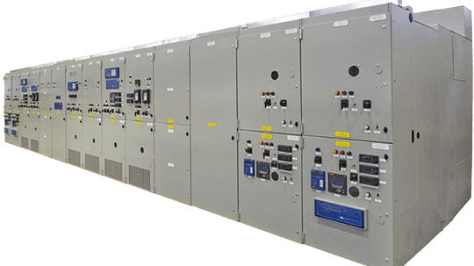

Project description
Problem statement: “As industry demand grows, space inside medium voltage switchgear has become increasingly limited. Manufacturers are required to fit more devices and wires within the same limited space. Additionally, manufacturers are now being asked to include a remote viewing system within the switchgear to monitor a physical ground switch. This ground switch is physically blocked, by wires, from the view of the operator.”
Notes:
Erica: Our project sponsor is powell industries which is a “Powell Industries designs and manufactures equipment like switchgear, circuit breakers, and power management systems that help safely control and distribute electrical power in multiple different industries
Switchgears are Switchgears are devices that control and protect electrical circuits by turning power on or off and preventing damage during electrical faults.
Powell industries designs/maufactures
explain switchgears
explain project

Slide 3
System Overview
Power Supply
Thermal Sensor
Battery
Website
Converters
Microcontroller
Julia, Blake, Erica
Notes:
Julia: Design the power supply and overall hardware of the system.
Blake: Microcontroller coding and ML
Erica: Creating Web Application for users to interact with

Slide 4
Project Timeline
Jan 22: Designed and ordered new PCB + started integrating Microcontroller/Website | Feb 3: Have PCB soldered and tested + Website/Microcontroller connection | Feb 17: Microcontroller can send image data to website + ESP32 on PCB able to download code | Feb 24: Have PCB working and have microcontroller programmed + switch state communication | Mar 3: All Integration between subsystems complete | Mar 24: Practice Demo + Completing Final Report + Preparing for Showcase
Notes:
Eric

Slide 5
Subsystem 1: PCB
Julia
Accomplishments since last update 15 hrs of effort | Ongoing progress/problems and plans until the next presentation
ESP32 on board downloaded code. Replacement board has been designed and ordered. | The camera socket isn’t viable. The socket and 3 buck converters need to be replaced with a connector and a breakout board.

Slide 6
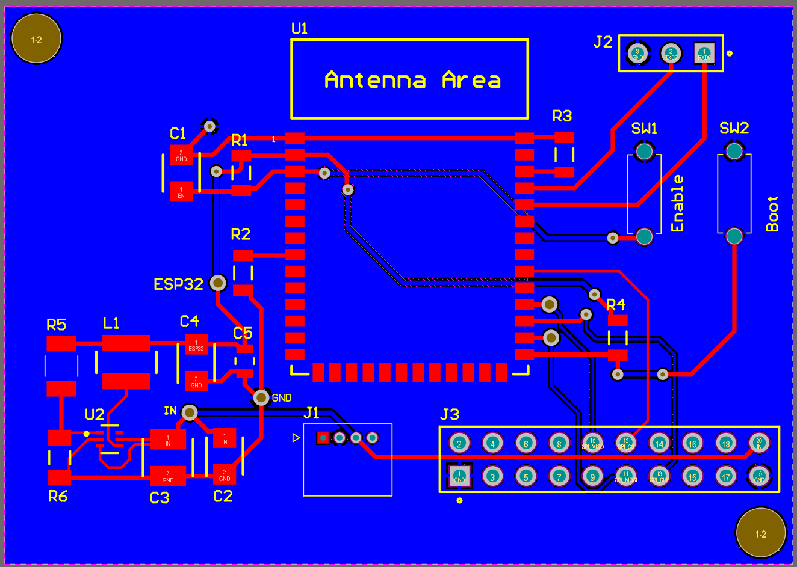
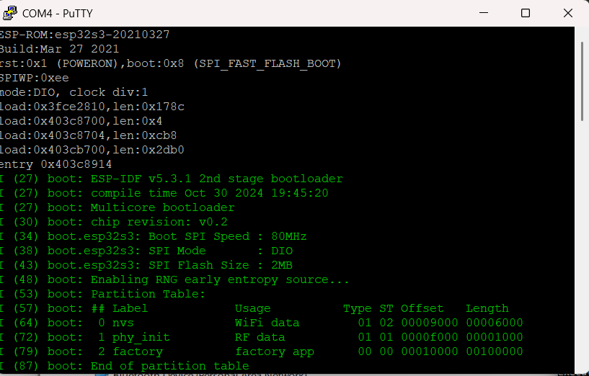
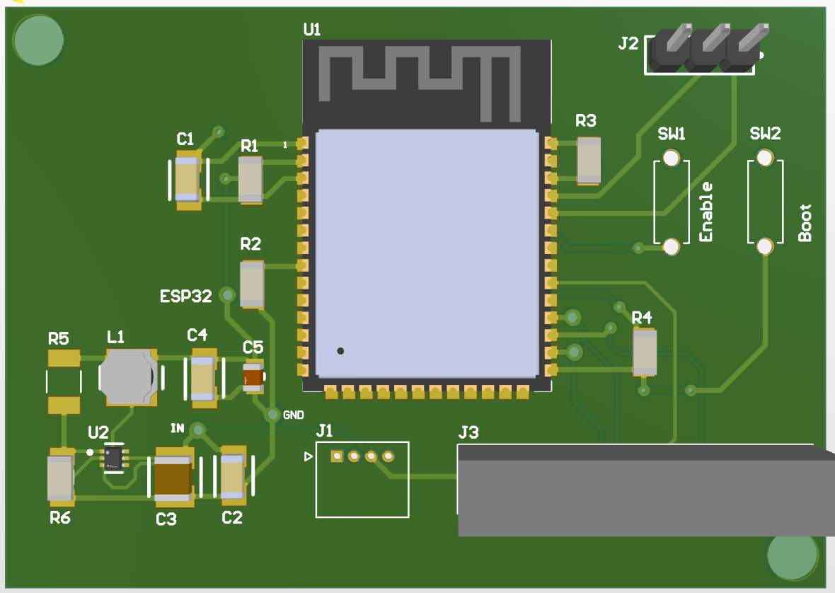
Subsystem 1: PCB
Julia
Replacement Board Layout
Code running on PCB shown in putty.exe
Replacement Board 3D model

Slide 7
Subsystem 2: Microcontroller
Blake
Accomplishments since last update 21 hrs of effort | Ongoing progress/problems and plans until the next presentation
Research on image encoding determined there wasn’t enough space on the microcontroller to perform the task. Added test code to allow for the pixel values to be put into MatLab manually and see the normalized photo Microcontroller’s code has been downloaded to PCB. Image data is successfully being sent from the microcontroller to the website | The code for switch-state determination needs to be updated. Work on sending multiple frames Put together switch-state demos Send switch-state data

Slide 8
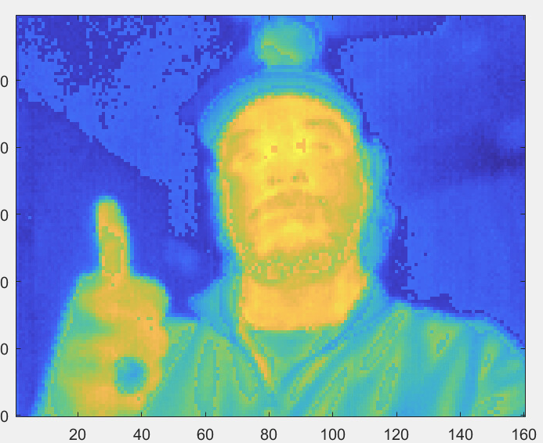
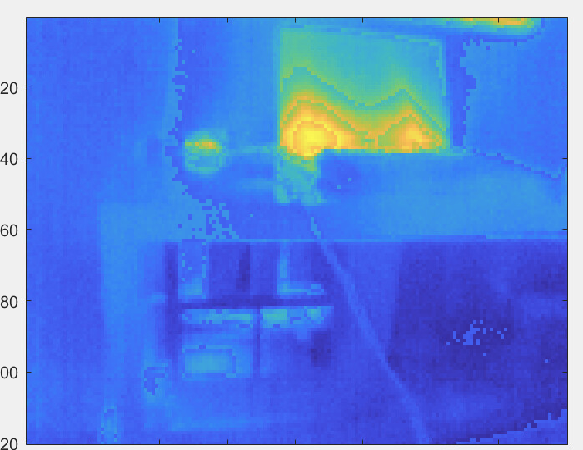
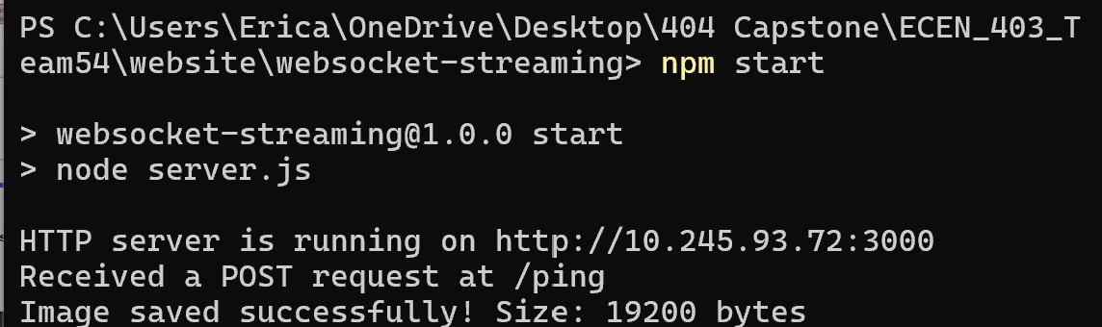
Subsystem 2: Microcontroller
Blake

Slide 9
Subsystem 3: Website
Erica
Accomplishments since last update 15 hrs of effort | Ongoing progress/problems and plans until the next presentation
Successfully received image data from microcontroller Worked on analyzing the raw grayscale data Successfully converted raw data to a png file using pillow numpy | Work on functionality of reading multiple image frames at real time and displaying them one by one Work on displaying switch state communication

Slide 10
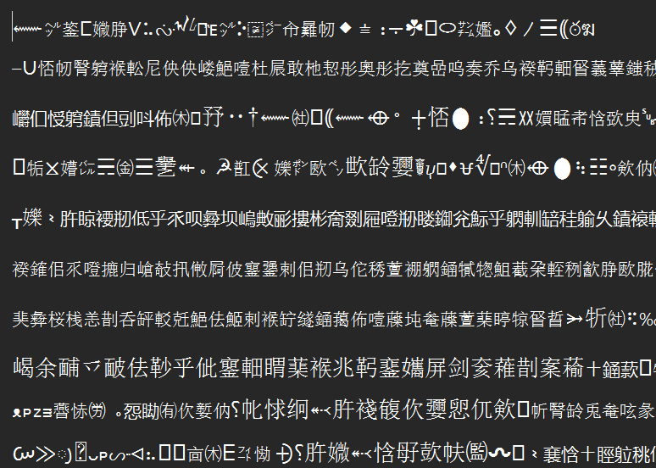
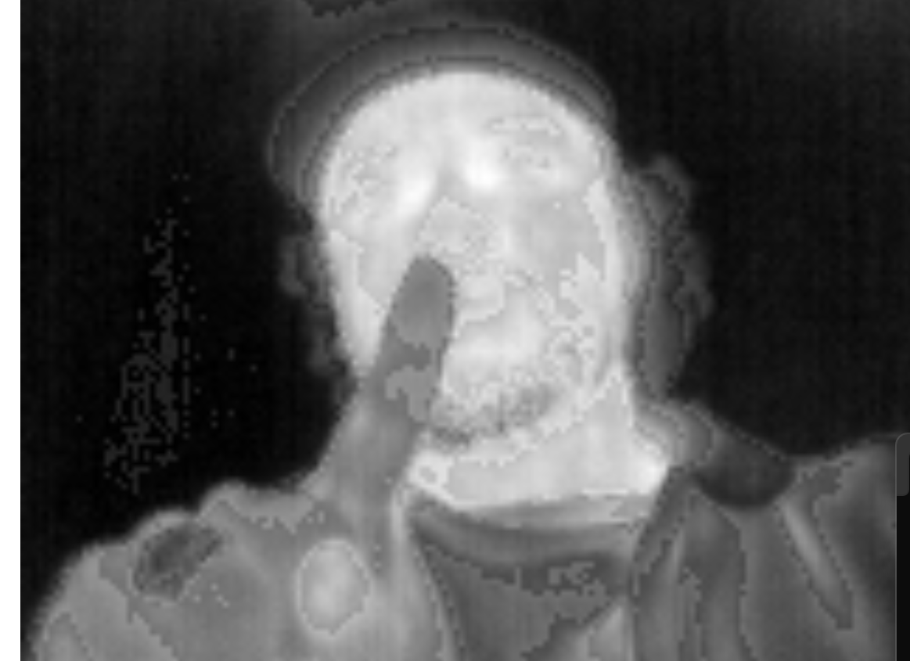
Subsystem 3: Website
Erica

Slide 11
Execution plan
 | 1/20/25 | 1/27/25 | 2/3/25 | 2/10/25 | 2/17/25 | 2/24/25 | 3/3/25 | 3/10/25 | 3/17/25 | 3/24/25 | 3/31/25 | 4/7/25 | 4/14/25 | 4/21/25 | 4/28/25
PCB Updated
Updated PCB ordered
Parts Ordered
Researched Integration
Microcontroller Code Modified
Website Code Modified
Status Update #1
New boards soldered
Verify Server can receive data from microcontroller
Buck converters tested
Website and Microcontroller Connection
UHMW Polyethylene sheet ordered |  |  |  |  |  |  |  |  | Not Started
Status Update #2 |  |  |  |  |  |  |  |  | In Progress
MCU and Website communication tested |  |  |  |  |  |  |  |  | Completed
PCB and Microcontroller Integration |  |  |  |  |  |  |  |  | Behind
UHMW Polyethylene Box made
MCU and Website Communicate Switch State
Dielectrics Testing
Status Update #3
Website and Microcontroller Fully Integrated
Full System Integration
Status Update #4
Troubleshoot any issues
Practice Demo
Status Update #5
Final Presentation
Final Demonstration
Final Report

Slide 12
Validation Plan
Test Name | Success Criteria | Methodology | STATUS | Engineers
Input Voltage | The voltage powering the whole PCB should be ~3.7 Volts | Use a multimeter to measure the DC voltage | PASSED | Julia
Converter Voltage | The buck converter providing voltage should produce ~3.3 Volts | Use multimeter to measure the DC voltage | PASSED | Julia
Board Communication | The ESP32 should receive data from camera | Use oscilloscope to measure the data stream | UNTESTED | Julia
Microcontroller connect to website | The Website successfully received an HTTP POST request from the microcontroller. | Checking the console log of both the website and microcontroller | PASSED | Erica + Blake
Microcontroller sending an image data | The website successfully received raw image data | Checking console log on website and converting the raw image data to a png | PASSED | Erica + Blake
Switch State Working | The microcontroller should be able to identify the Switch State of a makeshift switch | The microcontroller will monitor a show box with an LED to demonstrate switch state determination | UNTESTED | Blake
The PCB should pass dielectrics test | The PCB should pass the dielectrics test and not cause any interference with the switchgear. | This will be tested at POWELL Industries | UNTESTED | Julia
Website can display switch state determination | The website should be able to accurately display the Switch State Determination. | We will test the State determination at POWELL/ with a makeshift switch | UNTESTED | Erica + Blake
Website can load and display images in real time | The website should be able to display a few frames per second to mimic a slow video stream. | When the camera is running, we will monitor the latency on the website | UNTESTED | Erica + Blake
Notes:
should we put one for switch state demo?

Slide 13
Thank you for listening!

